Slide 1

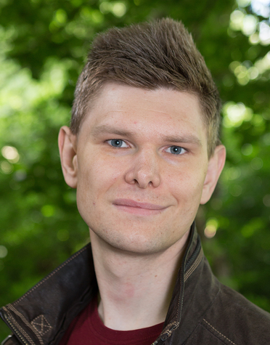

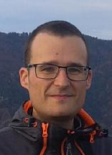
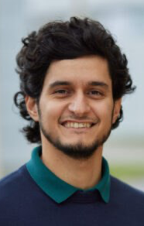


Team
Peter Willendrup DTU / ESS DMSC
Mads Bertelsen ESS DMSC
Gregory S Tucker ESS DMSC
Emmanuel Farhi Synchrotron SOLEIL
Tobias Weber Institut Laue-Langevin
José Robledo FZ Jülich / IAS / JSC
Team Mentors
Jan-Oliver Mirus FZ Jülich / IAS / JSC
Ilya Zhukov FZ Jülich / IAS / JSC

Slide 2
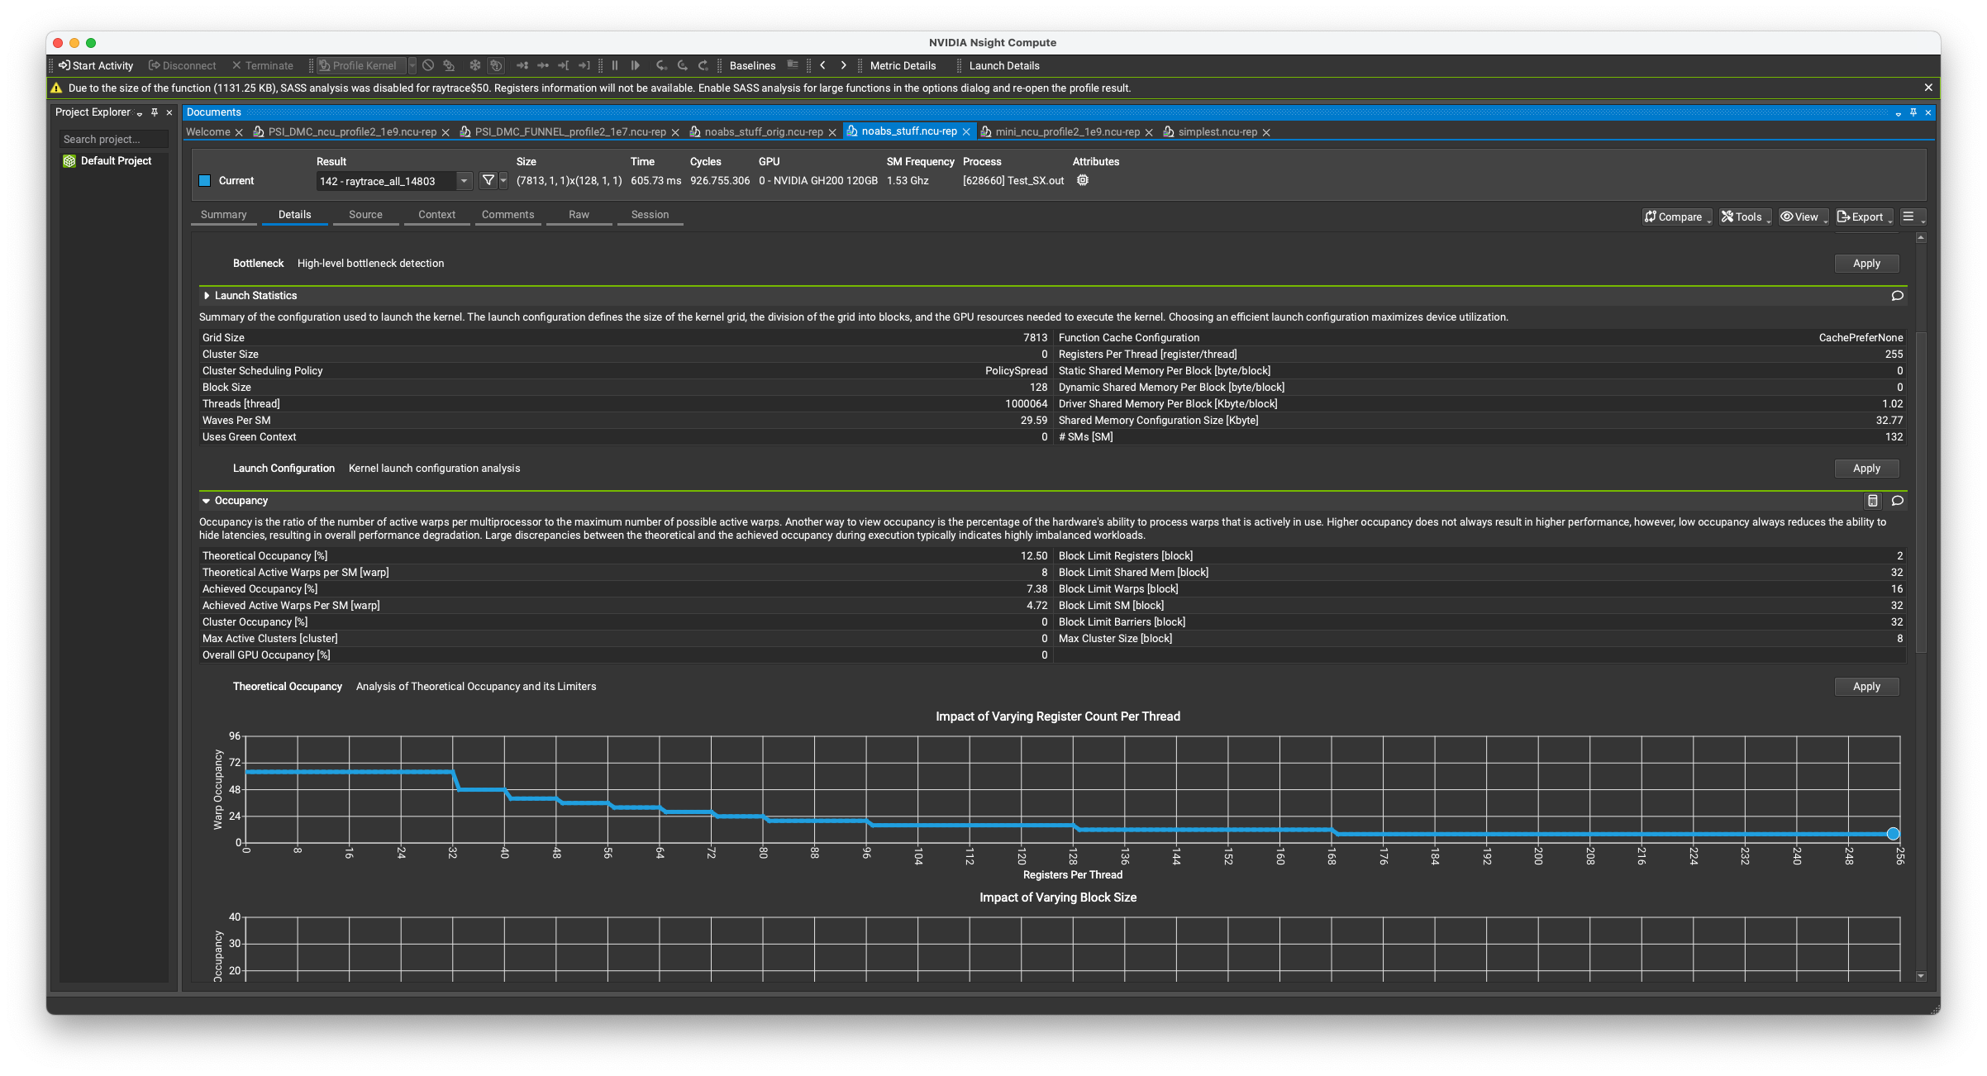
We are likely blocked by our “arrays of struct”
Profiler Output
Too many registers required pr. thread

Slide 3
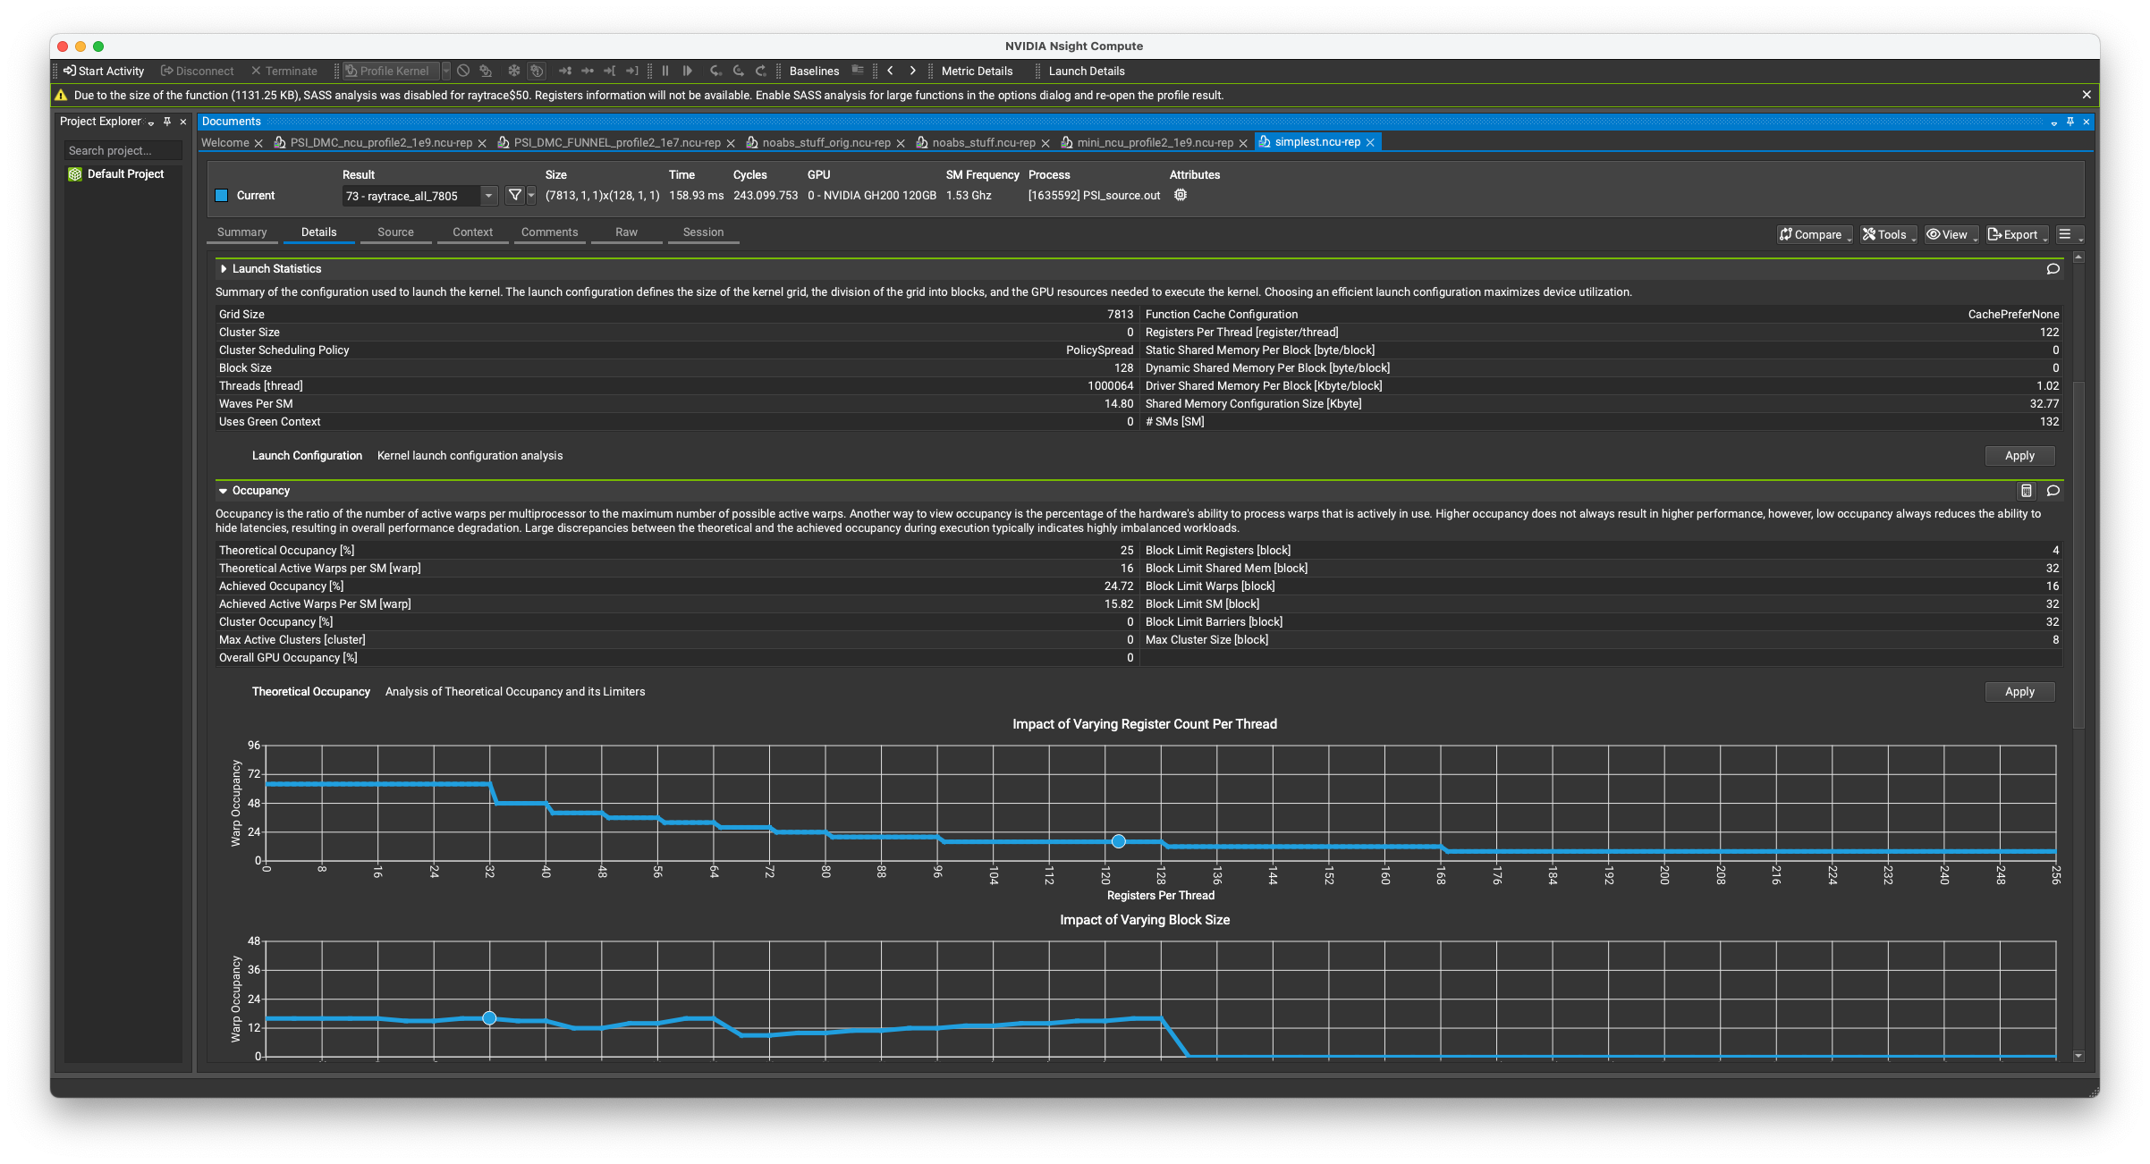
We are likely blocked by our “arrays of struct”
Profiler Output
Even the ‘simplest of all cases’ is not great in this respect

Slide 4
We are likely blocked by our “arrays of struct”
Even the ‘simplest of all cases’ is not great in this respect

Slide 5
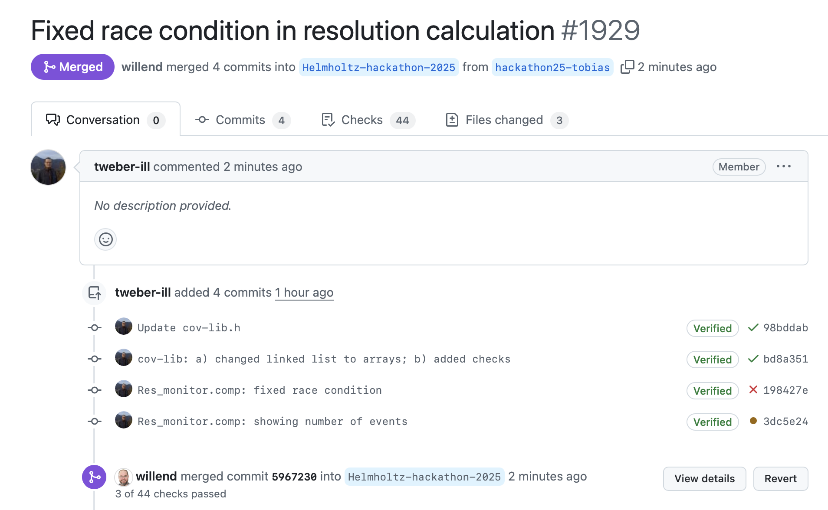
Progress and Goals
Tobias identified and corrected a thread race condition in a specific instrument / component
Emmanuel tried chatbot hints for potential missing #pragma’s in key component codes… “Not so easy” ;-)
Goals for today:
More profiling
Experiments with ‘struct with arrays’ approach
Take a look at alternative FUNNEL sorting algorithm (something readily provided in CUDA?)

Slide 6
Problems and Solutions
Refactoring to try out a new overall code structure is challenging
Hack local c-file is error prone vs. lots of work needed to ‘fully integrate’
Limit device-host-device transfers (only some data need to be loaded back to host)

